Slide 1

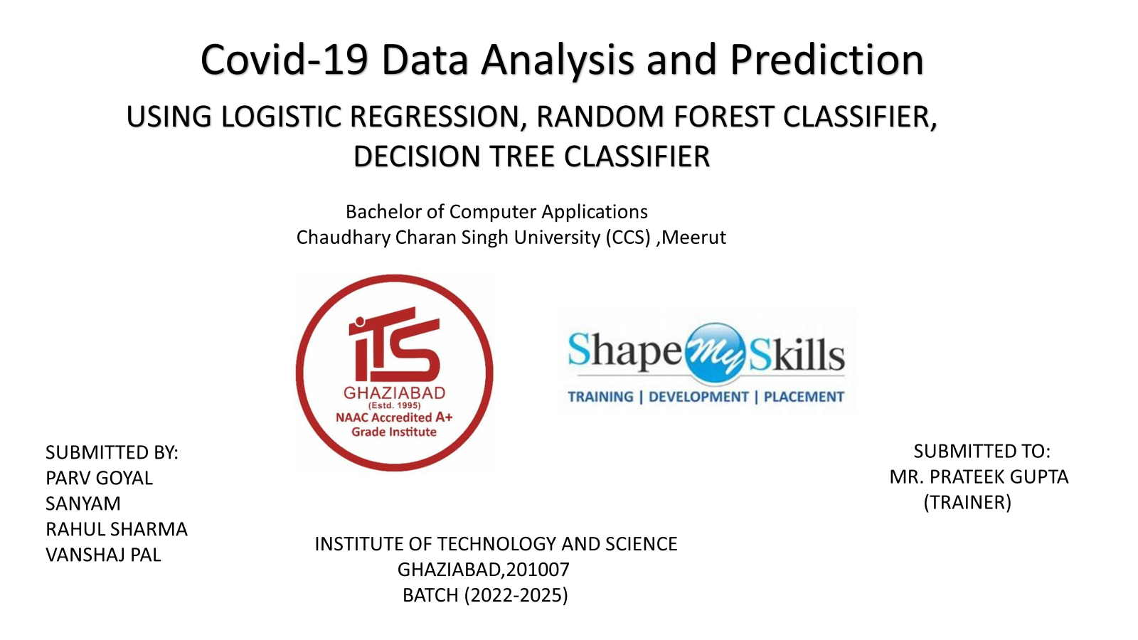

Slide 2
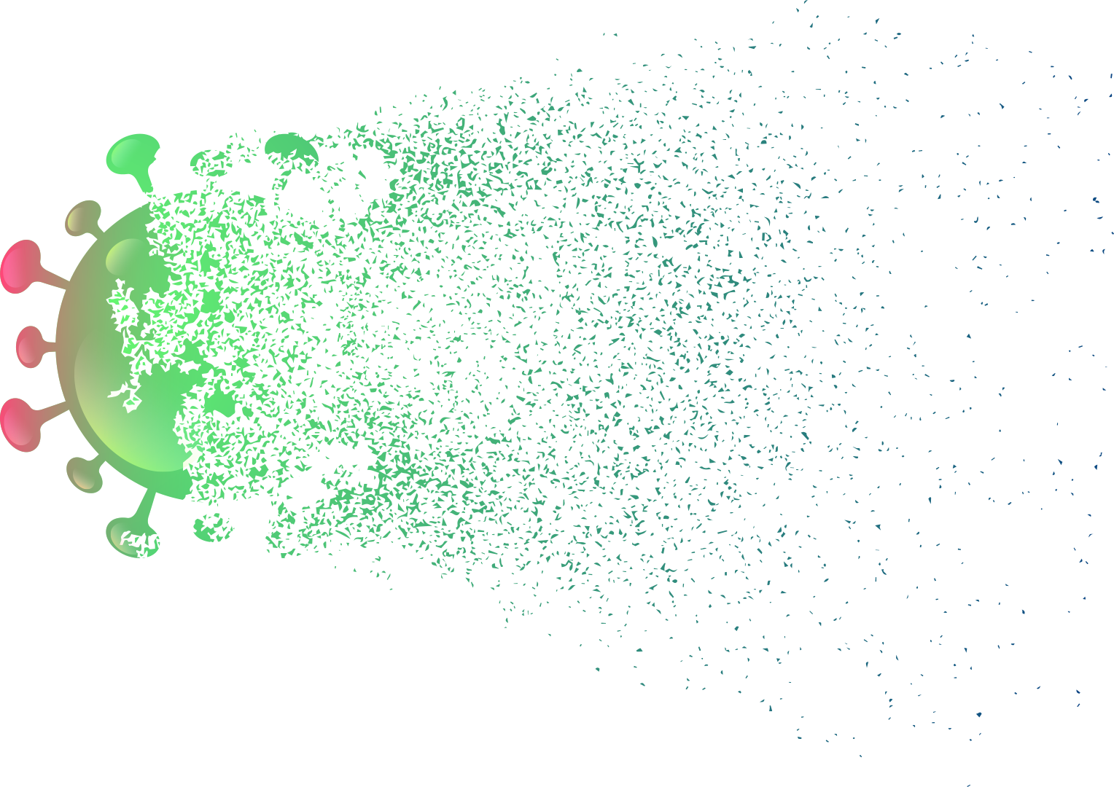

Covid-19 Data Analysis Using Deep Learning And Machine Learning

Slide 3
WHAT IS MACHINE LEARNING AND DEEP LEARNING
The art of Machine Learning unveils the creation of algorithms that bestow upon machines the ability to glean insights and forecast outcomes from intricate datasets.
A mystical domain within the realm of Machine Learning, dedicated to the intricate art of neural networks adorned with myriad layers, known as deep neural networks, proficient in unraveling vast and intricate data tapestries.

Slide 4


KEY CONCEPT USED IN PROJECT
Linear
Regression
Decision
Tree
Random
Forest
Cross
Validation
(implicit)
Confusion
Matrix

Slide 5
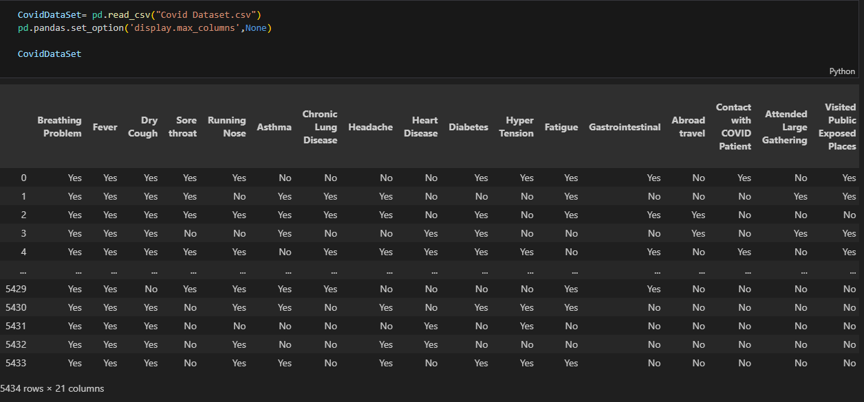
DATASET

Slide 6
Linear Regression
Linear regression, a spell of supervised machine learning, unveils the mystical bond between the celestial dependent variable and the ethereal independent features. By crafting a linear incantation from the stars, this sorcery foretells the future value of one entity through the cosmic whispers of another. The enigmatic entity awaiting divination is the dependent variable, while the herald of prophecy is the independent variable.

Slide 7
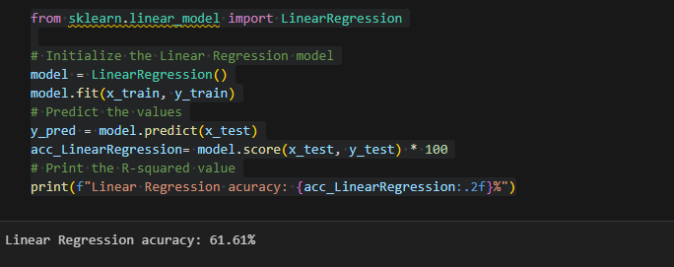
Linear Regression Accuracy

Slide 8
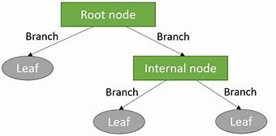
Decision Tree
In the realm of mystic knowledge, a decision tree unfolds like a map of fate, guiding seekers towards choices and prophecies. Its intricate design weaves nodes as gateways to decisions, branches revealing destinies, and leaf nodes blossoming with final truths or foretellings. Each node, a key to unlocking attributes, each branch, a thread leading to an outcome, and each leaf, a sacred sigil bearing a label of destiny or a whisper of unending value.
Structure of a Decision Tree

Slide 9
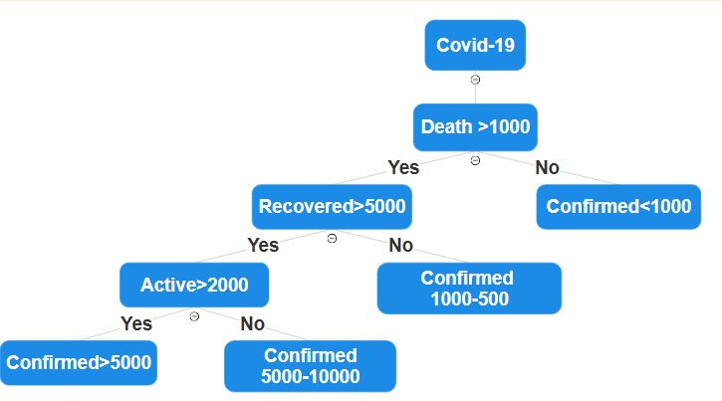
HOW DECISION TREES WORK?
1).Selecting the Best Attribute
To determine the optimal attribute for data segmentation, metrics like entropy or information gain are utilized.
2).Internal Nodes
Manifesting choices or trials based on qualities. Each core harbors one or more diverging paths.
3).Repeating the Process:
The ritual echoes on, weaving through each subset, birthing new nodes within until the cosmic decree halts the incantation.

Slide 10
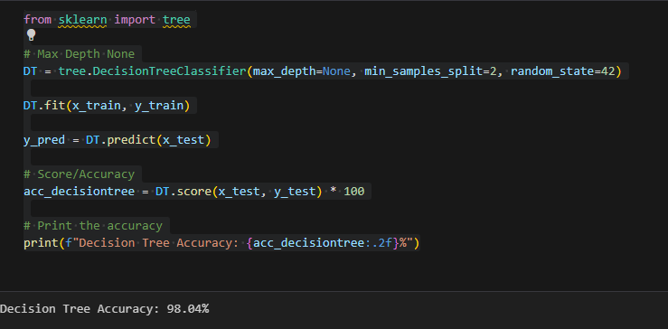
Decision Tree Accuracy

Slide 11
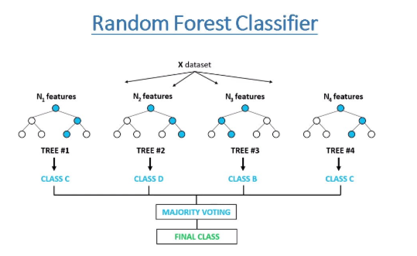
Random Forest
The Random Forest, a mystical amalgamation of arboreal wisdom, merges myriad decision trees to enhance foresight accuracy and resilience. Esteemed for its prowess in realms of classification and regression, this enchanting method beckons with its prowess and simplicity.
Structure Of Random Forest

Slide 12
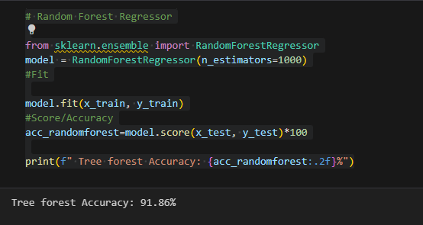
Random Forest Accuracy

Slide 13
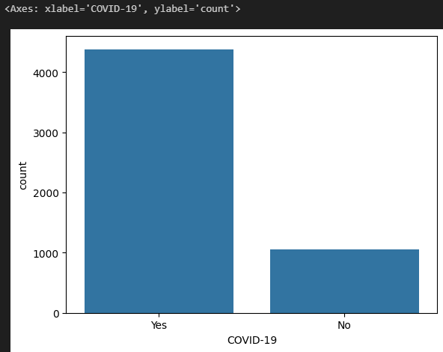
Covid-19 countplot graph

Slide 14
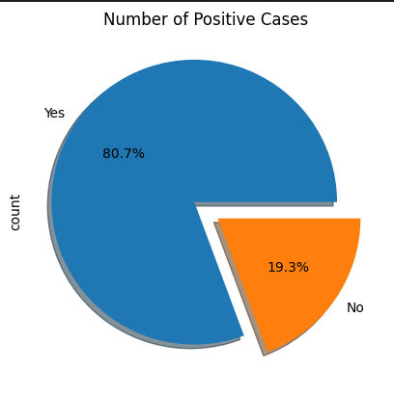
Plotting number of positive cases
The pie chart shows the distribution of positive cases. The majority of cases (80.7%) are positive, while 19.3% are negative. The chart is titled "Number of Positive Cases" and has labels for "Yes" and "No" to indicate the categories

Slide 15
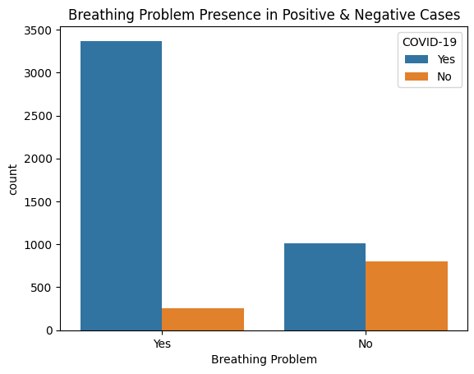
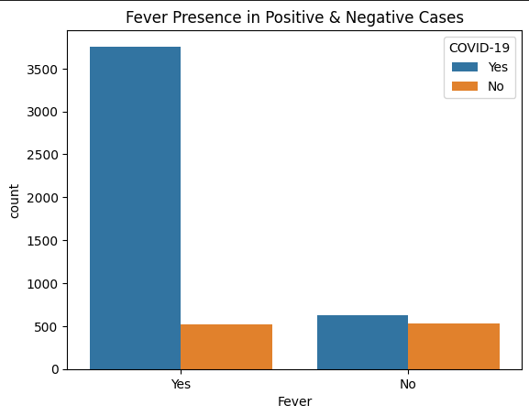
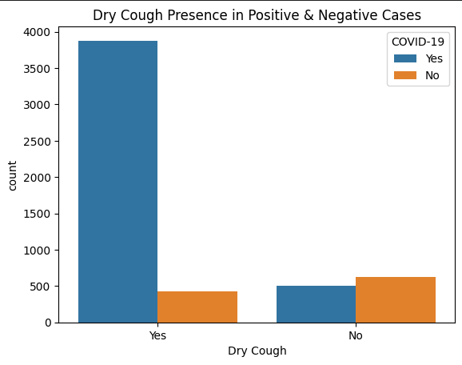
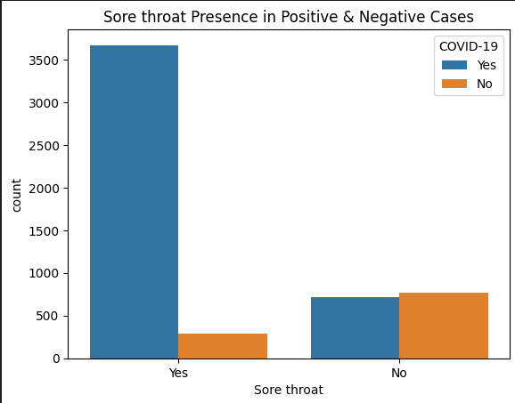
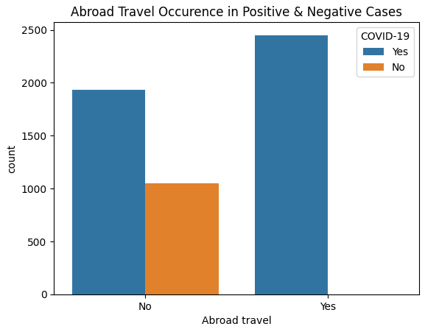
Plotting problems present in Covid-19 positive and negative cases

Slide 16

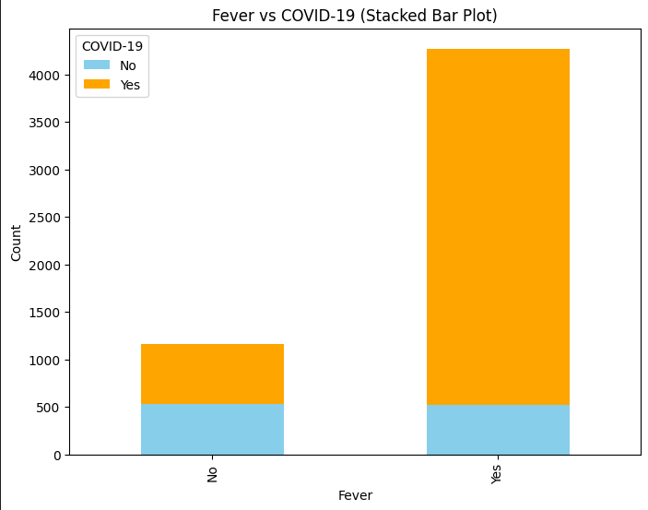
Fever Vs Covid-19 (Stacked Bar plot)

Slide 17
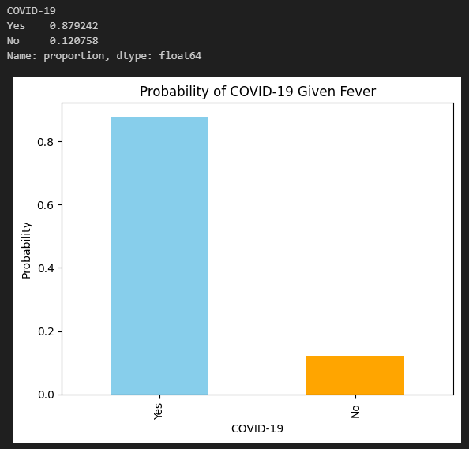
Probability of covid-19 given fever

Slide 18
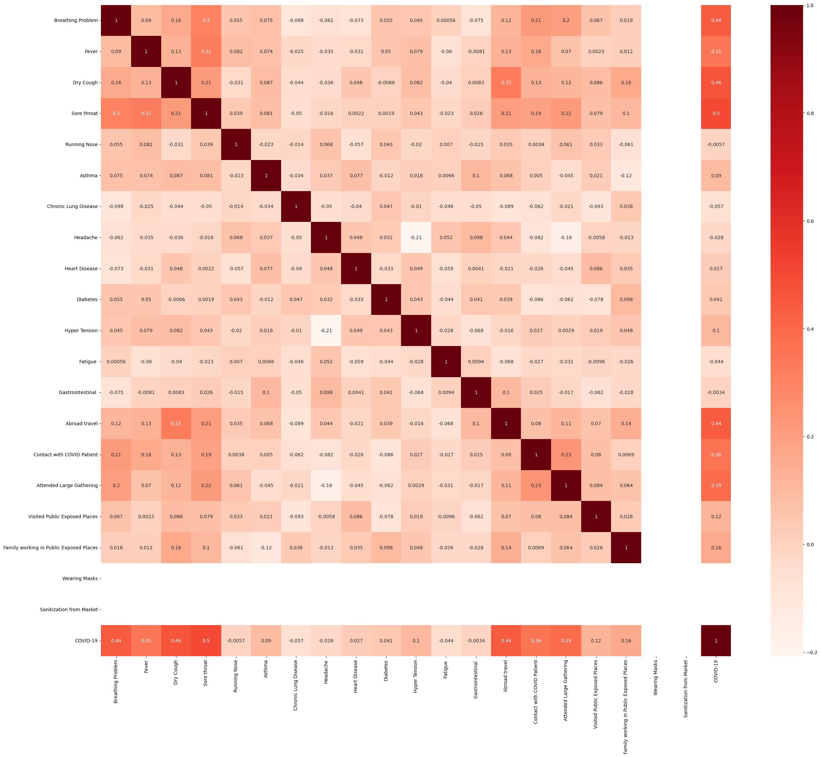
Heat Map
The heatmap shows the correlations between different variables related to COVID-19. Darker colors indicate stronger correlations, either positive or negative. The specific variables and their correlations can be interpreted by examining the labels and values on the heatmap.

Slide 19
Risk factors
Age
Genetics
Many diseases occur more frequently in certain age brackets
Some diseases have a hereditary component and can be passed down through families
Lifestyle
Environment
Certain behaviors can increase the risk of developing
certain illnesses
Exposure to certain substances in the environment can increase the risk of developing some diseases
Medical History
Gender
A personal or family history of certain illnesses can increase the risk of developing related conditions
Some illnesses are more common in one gender than the other

Slide 20
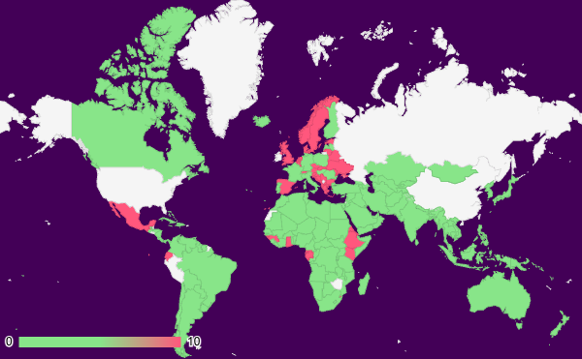
Disease prevalence
0-5% of the population in these regions are affected by the disease
6-14% of the population in these regions are affected by the disease
15-30% of the population in these regions are affected by the disease
Follow the link in the map to modify its data and then paste the new one here. For more info, click here

Slide 21
Risk factors and complications
Risk Factors | Description | Prevalence | Contributing Factors | Complications | Severity
Age over 50 | Being over the age of 50 | 80% of cases | Age-related decline in immune function | Heart attack, stroke, kidney damage, blindness | High
Smoking | Using tobacco products | 30% of cases | Nicotine addiction, exposure to carcinogens | Lung cancer, chronic obstructive pulmonary disease (COPD) | Moderate
High blood pressure | Blood pressure consistently above 140/90 mm Hg | 40% of cases | Obesity, stress, genetics | Heart disease, stroke, kidney damage, vision loss | High
Family history of disease | Genetic predisposition to the disease | 10% of cases | Family history | Heart disease, stroke, kidney damage, blindness | Moderate

Slide 22
Thanks!

